Slide 1
Structures
Just because you put your data in a struct doesn’t mean your data is structured

Slide 2
Structured Data vs. Bag O’ Data
Common pitfalls and easy tips.

Slide 3
Don’t mix context information with data to be transformed.
These are two unrelated sets of data.

Slide 4
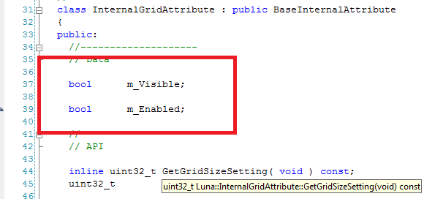
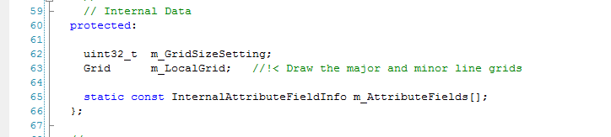
Example 1: How does the above relate to the below?

Slide 5
Example 2: Mixing state machine state and transformed data

Slide 6
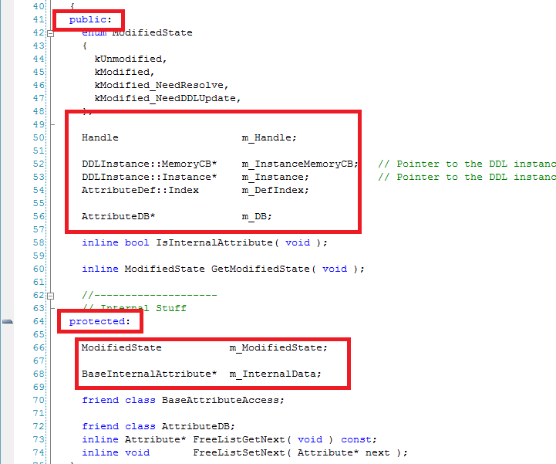
Example 3: Public, protected, private data

Slide 7
There’s no such thing as “optional” data.
“Optional” is context information. Separate that data.

Slide 8
Don’t mix data with different lifespans.
Example:
Update classes.
Build-time data versus runtime data.
“Lifespan” is context.
You’ll spend half the time just checking to see if the data exists.

Slide 9
For each vs. For all
“For each” considered harmful.
What if branching was one of the most expensive things you could do on the CPU? …oh, wait.

Slide 10
Easy Step #1: SOA
SOA by default.
Combine as appropriate.

Slide 11
Easy Step #1: SOA
Combine based on use:
e.g. xyzw
SOA by default.
Combine as appropriate.

Slide 12
Easy Step #1: SOA
Combine based on use:
e.g. xyzw
What about conflicting combinations?
This problem already exists.
SOA by default.
Combine as appropriate.

Slide 13
Easy Step #1: SOA
Combine based on use:
e.g. xyzw
Can solve for cache coherency.
~2B PPU cycles/sec wasted on waiting for memory.
What about conflicting combinations?
This problem already exists.
SOA by default.
Combine as appropriate.

Slide 14
And, of course… Concurrency.
Separating data by context makes it much simpler to solve for data concurrency.

Slide 15
Real-life example: David Thall

